Slide 1
Inheritance I

Slide 2
Introduction to Inheritance
Inheritance is one of the main techniques of object-oriented programming (OOP)
Using this technique, a very general form of a class is first defined and compiled, and then more specialized versions of the class are defined by adding instance variables and methods
The specialized classes are said to inherit the methods and instance variables of the general class
Base Class
Derived Class

Slide 3
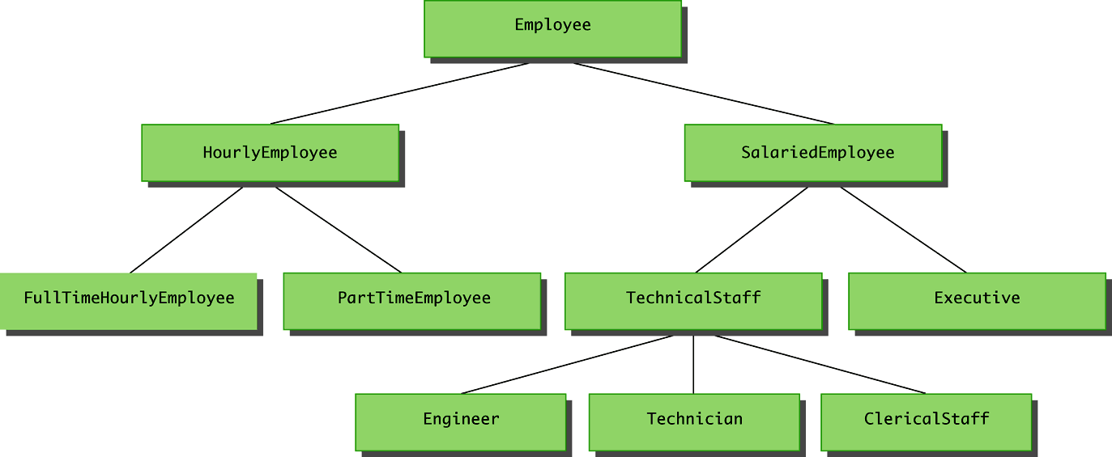
Employee Example

Slide 4
Employee Example
Employee
HourlyEmployee
SalariedEmployee

Slide 5
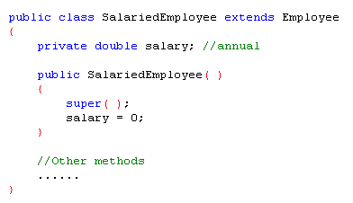
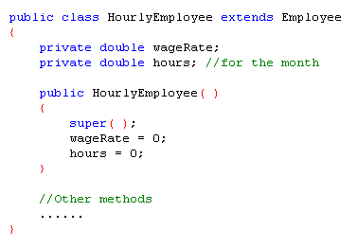
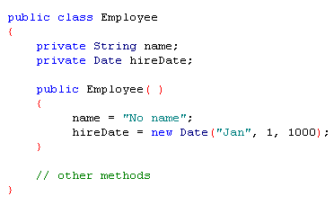
Employee Example

Slide 6
Introduction to Inheritance
Inheritance is the process by which a new class is created from another class
The new class is called a derived class
The original class is called the base class
A derived class automatically has all the instance variables and methods that the base class has, and it can have additional methods and/or instance variables as well
Inheritance is especially advantageous because it allows code to be reused, without having to copy it into the definitions of the derived classes

Slide 7
Derived Classes
Since an hourly employee is an employee, it is defined as a derived class of the class Employee
A derived class is defined by adding instance variables and methods to an existing class
The existing class that the derived class is built upon is called the base class
The phrase extends BaseClass must be added to the derived class definition:
public class HourlyEmployee extends Employee
The derived class inherits all the public methods, all the public and private instance variables, and all the public and private static variables from the base class
The derived class can add more instance variables, static variables, and/or methods

Slide 8
Inherited Members
A derived class automatically has all the instance variables, all the static variables, and all the public methods of the base class
Members from the base class are said to be inherited
Definitions for the inherited variables and methods do not appear in the derived class
The code is reused without having to explicitly copy it, unless the creator of the derived class redefines one or more of the base class methods

Slide 9
Parent and Child Classes
A base class is often called the parent class
A derived class is then called a child class
These relationships are often extended such that a class that is a parent of a parent . . . of another class is called an ancestor class
If class A is an ancestor of class B, then class B can be called a descendent of class A

Slide 10
Method Overriding
Although a derived class inherits methods from the base class, it can change or override an inherited method if necessary
In order to override a method definition, a new definition of the method is simply placed in the class definition, just like any other method that is added to the derived class

Slide 11
Overriding Versus Overloading
Do not confuse overriding a method in a derived class with overloading a method name
When a method is overridden, the new method definition given in the derived class has the exact same number and types of parameters as in the base class
When a method in a derived class has a different signature from the method in the base class, that is overloading
Note that when the derived class overloads the original method, it still inherits the original method from the base class as well

Slide 12
The final Modifier
If the modifier final is placed before the definition of a method, then that method may not be redefined in a derived class
It the modifier final is placed before the definition of a class, then that class may not be used as a base class to derive other classes

